Slide 1
Data Mining Functionalities
What kinds of Pattern can be Mined?

Slide 2
Data Mining Functionalities –
It specifies what kind of patterns to be found in data mining tasks.
Two categories of data mining tasks – Descriptive and Predictive tasks
Descriptive mining tasks characterize/form the general properties of the data in the database
Predictive Mining tasks performs inference on the current data in order to make predictions

Slide 3
Data Mining Functionalities – What kinds of Pattern can be Mined?
Discover patterns of different granularity (different level of abstraction)
Some patterns may not hold for all data in the database, a measure of certainty or trustworthiness is usually associated with each discovered pattern

Slide 4
1 Concept / Class Description: Characterization and Discrimination
Data can be associated with classes or concepts
Ex:- AllElectronics Store
computers and printers are example for Classes of items for sale .
bigSpenders and budgetSpenders are concepts of customers

Slide 5
Concept / Class Description:
It describes classes or concepts in summarized, concise and precise terms
Description can be generated by
Data Characterization
Data Discrimination
Data Characterization and Discrimination

Slide 6
Data Characterization
It is a summarization of the general features of a target class.
The features of target class are typically collected by a database queries
Effective method for data characterization
Based on statistical measures and plots
Data cube based OLAP roll-up operation
Attribute Oriented Induction

Slide 7
Output of Data Characterization
Pie Charts
Bar Charts
Curves
Multi Dimensional Data Cubes
Multi Dimensional Tables
Generalized Relations/Characteristic Rules

Slide 8
Data Discrimination
Process of comparison of the general features target class objects with the general features contrasting classes objects
Target class and contrasting class are specified by users and its features can be retrieved by database queries

Slide 9
Data Discrimination output
The output of data discrimination are Discriminant Rules.
Rules include comparative measures that help to distinguish between target and contrasting class

Slide 10
Example
Customers who shop for computer products regularly with Customers who shop computer products rarely
80% of customers who frequently purchase computer products are between 20 and 40 years and have a university degree whereas 60% of customers who infrequently buy computer products are either seniors or youths and have no university degree.

Slide 11
2 Mining Frequent Patterns , Associations, and Correlations
Frequent Patterns are Patterns that occur frequently in data.
frequent patterns can be frequent itemsets, subsequences and substructures.
A frequent itemset typically refers to a set of items that frequently appear together in a transactional dataset.
Example is Milk , Bread, Butter, Jam.

Slide 12
Frequently occurring subsequence
Customer tends to purchase first PC, followed by a digital camera, and then a memory card.
Frequently occurring substructures is called structured patterns
Mining frequent patterns lead to the discovery of interesting associations and correlations within data.

Slide 13
Association Analysis
An example for a rule mined from the AllElectronics transactional database is
buys(X,”computer”)→buys(X,”software”) [support=1%, confidence= 50%]
Where X is a variable representing customer
Confidence/Certainty of 50% means that if a customer buys a computer , there is 50% chance that she will buy software aswell.
1% support means that 1% of all of the transaction under analysis showed that computer and software purchased together
Single dimensional association rules – contains only one predicate

Slide 14
Association Analysis
Multidimensional Association rule
age(X,”20..29”) and income(X,”20K…29K”)-> buys(X,”Cdplayer”)[support=2%,confidence=50%]
Association rules are discarded as disinteresting if they do not satisfy minimum support threshold and a minimum confidence threshold.

Slide 15
3 Classification and Prediction
Classification is the process of generating a model that describes a data class.
This class model can be used to classify the class of objects whose class label is unknown.
Model is created by analyzing the training data set.

Slide 16
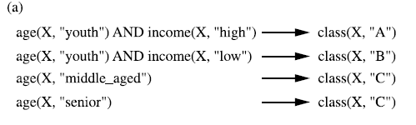
Classification Model using IF-Then Rules

Slide 17
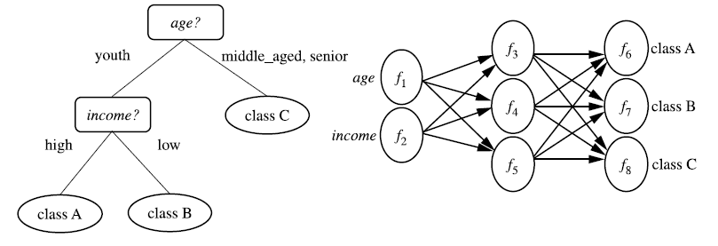
Classification Models using Decision Trees and Neural Networks

Slide 18
Prediction
Prediction predicts numeric values
Prediction is used to predict missing or unavailable numerical data values
Regression Analysis is a statistical method for numerical prediction
Example amount of revenue each item generate in the next year.

Slide 19
Classification and Prediction are preceded by relevance analysis
Relevance analysis identify attributes that do not contribute to the classification or prediction .
Irrelevant attributes can then be excluded.

Slide 20
4 Cluster Analysis
Analyze data objects without consulting class label
Class label are not present in the training data
The objects are clustered based on the principle of maximizing the intraclass similarity and minimizing the interclass similarity
Each cluster can be viewed as a class of objects, for which rules can be derived.

Slide 21
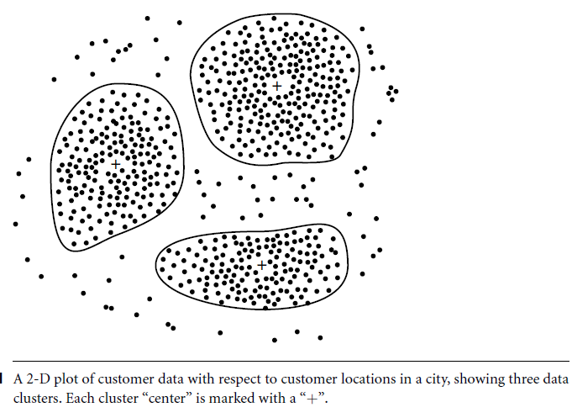

Slide 22
Outlier Analysis
Outlier – Data objects that do not comply with the general behavior or model of the data
Outlier can be detected using
Probability model for the data
Probability distribution of the data
Distance measures
Deviation based methods

Slide 23
Outlier Analysis
Most data mining methods discard outliers as noise or exceptions
In some applications like fraud detection, rare events are interesting so we do outlier analysis

Slide 24
Evolution Analysis
Evolution Analysis describes and models regularities or trends for objects whose behavior changes over time.
Time series data analysis
Sequence or periodicity pattern matching
Similarity based data analysis

Slide 25
Evolution analysis
Suppose that you have the major stock market (time-series) data of the last several years available from the New York Stock Exchange
Evolution analysis will help you to decide whether to invest in shares of high-tech industrial companies.
A data mining study of stock exchange data may identify stock evolution regularities for overall stocks and for the stocks of particular companies.
Such regularities may help predict future trends in stock market prices, contributing to your decision making regarding stock investments.

Slide 26
Challenges in Data Mining
Noisy and incomplete data
Real-world data is heterogeneous, incomplete and noisy.
Distributed data
Real world data is stored on different platforms in distributed computing environments.
Complex data
Real world data is heterogeneous and may contain images, audio, video, temporal data, spatial data, time series data , natural language text etc.

Slide 27
Performance
Depends on efficiency of algorithms and techniques used.
Incorporation of background knowledge
Using background knowledge, more reliable and accurate data mining solutions can be found.
Data visualization
To display the output to the user in a presentable manner is important.
Data privacy and security
Data mining normally leads to serious issues in terms of data security, privacy and governance.

